Slide 1
Using an
Energy Aware Compiler Framework
to Evaluate Changes in Register File Size
towards ASIP-Design
L. Wehmeyer
S. Steinke
P. Marwedel
University of Dortmund,
Germany
M. K. Jain
M. Balakrishnan
Indian Institute of Technology,
Delhi, India
Notes:
Work is the result of cooperation with IIT Dehli working on ASIP-Synthesis, we are working on compilers, so this work is one logical connection of these two subjects:
ASIP Designer needs Application Specific Information for his Design Decisions. A Compiler can supply this required information. We investigated the influence of a parameter that has not been intensively studied in the past: the size of the register file

Slide 2
Overview
Energy & Power
Register File Size
Experimental Environment
Methodology
Results
Conclusion

Slide 3
Energy & Power in ES
Power = Current * Voltage
  Primary influence on
  Lifetime
Energy = Power * Time
  Primary influence on
  Battery capacity
  Heat dissipation
Low Energy Systems:
  Reduce Power AND Time
Notes:
In the literature, power and energy are often used as synonyms. This is acceptable, but one shold be aware of the subtle differences.
Power is defined as Current multiplied with voltage. Talking about embedded systems, we can usually consider the operating voltage as a constant, since during normal operation, the voltage does not change drastivally. Power can thus be expressed in terms of the current that is being drawn from the battery at one point in time.
Bearing these things in mind, one can state that power has an influence on the lifetime or reliability of embedded systems, since strong power peaks cause electromigration, which can gradually lead to a failure of the interconnection network.
From physics class, everyone should remember that E = P * t. That is, power is only considered for one moment, whereas energy also considers the length of time this power is consumed.
Energy dissipation determines the possible running times for mobile embedded systems like mobile phones or laptops (if no wall socket is available). The less energy is dissipated by a system, the less capacity is required for the battery (which is a cost factor), or the longer running time can be realized (which is an important feature for the potential buyer!). Cooling requirements are also an important issue: in order to function normally, a processor has to be kept within a specified temperature range. The measures required for this (packaging and cooling) are almost as expensive as the actual chip itself in modern processors.
What does a designer of an embedded system have to bear in mind in order to develop a low energy system?
He has to thrive to keep both the power consumption AND the running time of the application low. Usually an optimization for performance (i.e. running time) will thus also have a positive effect on overall energy consumption. However, there are some cases where the two goals are actually contradictory: a program with longer running time may actually consume less energy, if the instructions cause a very low processor current to be drawn. This is one of the reasons why we developed an energy aware compiler that will be introduced a little later.

Slide 4
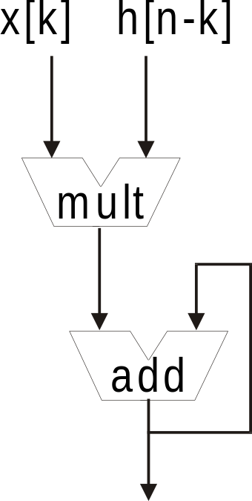
ASIP Design
ASIP (Application Specific Instruction set Processor):
Intermediate between ASICs and GPPs
Exploit knowledge about Application
Example: Convolution in DSPs
N
y[n] = x[n] * h[n] = Σ x[k]h[n-k]
k=-N
Notes:
An ASIP (or Application Specific Instruction Set Processor) is basically a hybrid form Between an ASIC (Application Specific Inegrated Circuit) and a General Purpose Processor:
The ASIC is designed ‚from scatch‘ to meet the required specification – its development is expensive, but the resulting chip is very fast and efficient due to the fact that it is highly specialized.
A General Purpose Processor on the other hand has a fixed architecture – it can perform a variety of Calculations (more than an ASIC generally can!), however, it is slower. What a GPP can do depends mainly on the software that is written for it.
Finally, a particular ASIP does not have an arbitrary architecture like an ASIC, nor does it have a Fixed hardware like a GPP. Rather, it has some features that can be easily changed if the applications scenario makes it worthwhile. Thus, an ASIP is something like a pre-produced chip that can Be configured by the costumer according to its application. That is, knowledge about the Application can be expoited to build the ASIP in such a way that the main task can be executed efficiently.
For example, a DSP that is used for signal processing will most probably have to convulute two signals at one time or another. If this application is very frequent, the designer will ensure the DSP has a datapath as shown on the right, so that the single steps of the convolution can be performed in one clock cycle.

Slide 5
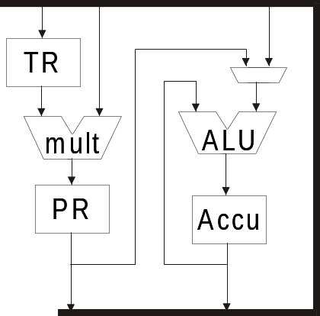
Register File Size
Number of registers:
important design decision
  for ANY processor!
Examples:
  TMS320C25 (C25): 3 registers
  M3-DSP
  ARM7TDMI
Notes:
It is clear that the number of registers is a crucial design decision step when a new processor is to be produced. To show the range (even within the DSP area), we first look at the slightly outdated C25 DSP by Texas Instruments, which has only three registers in ist actual data path: TR, PR and an Accumulator register. (Yes, there are some additional address registers).
Like in this example, I will highlight the hotspots using red rectangles – see if you can spot the circle ☺

Slide 6
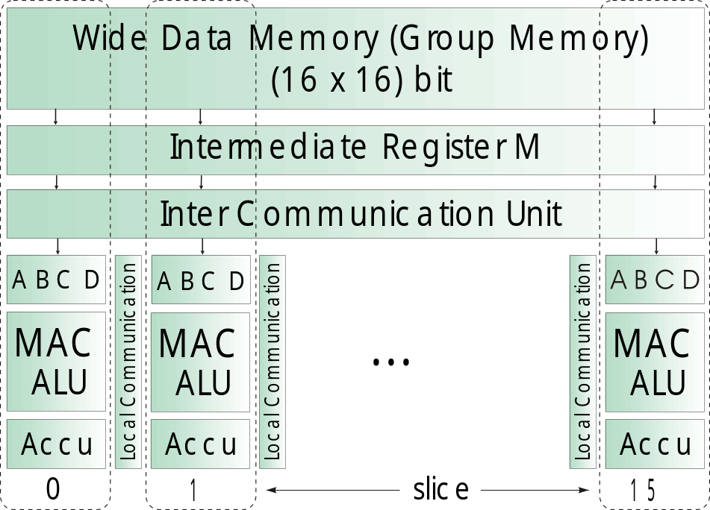
Register File Size
Number of registers:
important design decision
  for ANY processor!
Examples:
  TMS320C25 (C25)
  M3-DSP: 80 registers
  ARM7TDMI
Notes:
On the other hand, the relatively new M3-DSP platform features a much larger register file size. It is scalable concerning the number of so-called ‚slices‘ or data-paths. One instantiation (for which my colleague Markus is currently developing a code generator based on genetic algorithms) with 16 slices has 5 registers per slice, i.e. 80 registers all together. (Intermediate Register ‚M‘ is basically just for latching memory data) These 80 registers are however not homogeneous (as indicated in the picture), i.e. the connections and feedback lines are not arbitrary.

Slide 7
Register File Size
Number of registers:
important design decision
  for ANY processor!
Examples:
  TMS320C25 (C25)
  M3-DSP
  ARM7TDMI: 8 registers in THUMB mode
Notes:
Every processor has a specific number of registers that are used to hold data directly in the processor core. Thus, registers are fast and efficient, at least compared to main memory accesses. The caches we just saw are basically an attempt to close the gap between memory and registers. The register file we see here consists of eight registers, numbered from 0 to 7. This is our initial setup of the ARM7TDMI processor. Now, within the compiler, we can simply take e.g. 3 registers away, i.e. the registers are physically still there, but the code generator does not use them anymore:

Slide 8
Register File Size
Number of registers:
important design decision
  for ANY processor!
Examples:
  TMS320C25 (C25)
  M3-DSP
  ARM7TDMI: 8 registers in THUMB mode
Notes:
Now the programs that we compile using our compiler will act as if only five registers were present in the processor. For data intensive applications, one can imagine that taking away a number of registers will have a negative impact on performance.
To be able to investigate the effects of modifying the register file size, we had to make some experiments, and the setup is shown...

Slide 9
Experiments
Benchmark
Suite
encc
Compiler
Instruction Set
Simulator
Register File
Size
Trace
Data
Notes:
Here.
We have a suite of benchmarks that are sent through the ‚encc‘ compiler, an energy aware compiler that is being developed by my colleague Stefan Steinke and myself. (You already got to know Stefan in his Position as organizer of this workshop) ‚encc‘ generates a program that can be simulated using the ARM Instruction Set Simulator (or downloaded directly onto our Evaluation board and executed there). From the simulation run, a trace analyzer extracts data on cyckletime, memory accesses and power consumption. The Register File Size parameter is fed into the compiler, and the compiler generates code for an n-register machine, i.e. the remaining registers are simply left unused. In this way we can see how the code quality changes when a processor has more or less registers.
For our research work, we decided to look primarily at the ARM processor core, specifically at the ARM7TDMI...

Slide 10
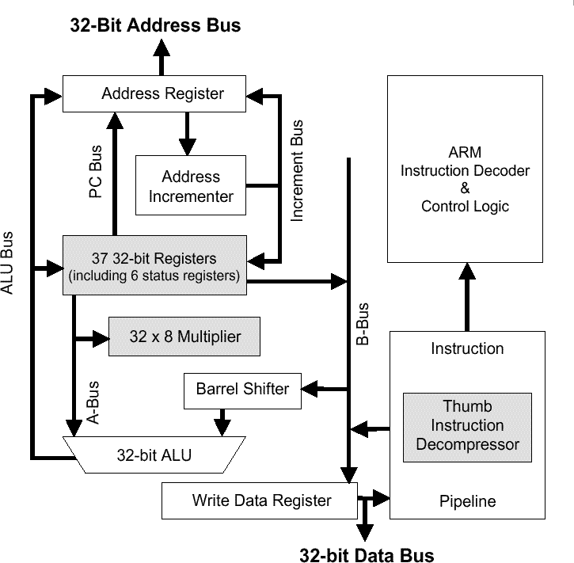
ARM7TDMI processor
Features:
32 Bit RISC
16 GP Registers
ALU, Multiplier, Shifter
2 Instruction Sets:
  ARM & THUMB
Evaluation Board:
4 KB On-Chip Memory
512 KB External RAM
Notes:
## insert 1 slide with picture of eval board!! ##
Whose basic architecture can be seen here
I already mentioned the multiplier and barrel shifter, apart from that it is a pretty straight-forward RISC CPU. It has a total of 16 general purpose registers and a homogeneous datapath.
The one special feature of the ARM processor is the fact that it supports two instruction sets, the 32-bit so called ARM instruction set, which supports all features of the processor core, and the 16 bit THUMB instruction set, which is especially well suited for low power applications. The main reason for this is the higher code density that can be achieved with a 16 bit code: for each instruction fetch, only half the number of bits need to be fetched from memory, or, the other way around, with one 32-bit access, two instruction words can be fetched. Since memory acesses account for a majority of power consumption, this is very power effective.
Of course, there are some drawbacks with the THUMB instruction set: Since the number of bits per instruction word is reduced by half, only eight of the 16 registers can be addressed, the remaining registers are only available for a small range of instructions. Also, the full capabilities of the processor can not be exploited with the THUMB instruction set, some features like a MAC operation or conditional execution is not possible.
Since THUMB rules for power saving, however, we developed our energy aware ‚encc‘ compiler for this partivular instruction set – thus, we will be using THUMB code in all our experiments.
One more thing should be said about the evaluation board that we used for building our power database:
It has a 4 KB On Chip scratch pad memory and a 512 KB external RAM. I will come back to the relevance of this issue later.

Slide 11
Benchmark Suite
Benchmarks chosen from typical domain of the ARM
DSP Algorithms: biquad_N_sections
lattice
matrix-mult
Media Application: me_ivlin
Standard Sorting Algorithms: bubble_sort
heap_sort
insertion_sort
selection_sort
Notes:
From this application scenario, we picked some applications that are typical for the ARM processor. They include 3 DSP-algorithms (2 filters, biquad and lattice, and a matrix multiplication), a Media application called me_ivlin and some standard sorting algorithms that are necessary at some time in nearly any larger application. In this case we looked at bubble, heap, insertion and selection sort.
These benchmarks were compiled using the energy aware encc-Compiler that was developed in our group.

Slide 12
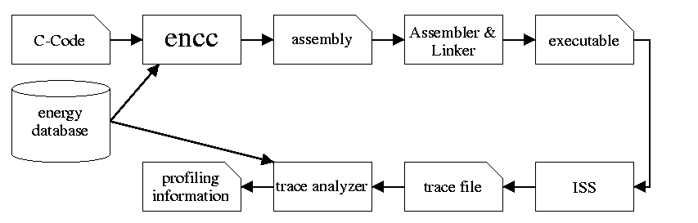
encc Compiler Environment
Energy Database obtained by physical measurement
  using the Evaluation Board
Extended Tiwari‘s Power Model to distinguish
    processor current
    memory current
Notes:
Since this workshop has an emphasis on compilers, I want to discuss our compiler a little more in-depth:
The general workflow is the same as in any compiler: From C-Code we generate an assembly code file. This file is assembled and linked to form an executable which is simulated using the instruction set simulator included in the ARM software development toolkit. The simulator generates a trace file including information about the executed instructions, cycles and memory accesses. The trace is analyzed by a trace analyzer that generates the desired profiling information.
Both the encc compiler and the trace analyzer take as input data from the energy database depicted on the left. This energy database was created by physically measuring the processor and memory current using our ARM evaluation board. The methodolgy to obtain the data is based on the work by Vivek Tiwari, who developed an Instruction-level power model to describe how much power isi consumed during execution of a specific instruction.
For the measurement, we repeated one instruction many times within a loop. („Many times“ to avoid loop overhead) This loop was in turn executed many times and the current drawn by the processor was measured. This is the power consumed by one instruction. Inter instruction effect, i.e. circuit state changes due to differnet subsequent instructions, are considered on an overall estimation basis, i.e. the average additional current drawn when two different instructions are executed one after the other was added to the values for the instructions themselves.
One major enhancement compared to Tiwari‘s power model is the fact that we also considered the power necessary to perform off-chip memory accesses – this power is often significantly larger than the power consumed by the processor itself.
What we basically have is thus a database containing power values for every instruction. This is used within the encc compiler during instruction selection to choose the instruction sequence that yields
The best results, depending on tthe desired cost function. The database is also used in the trace analyzer to determine the overall energy consumption of a complete program based on the trace file‘s information concerning executed instructions and kind and number of memory accesses.

Slide 13
Methodology
Steps to generate the data:
Generate code using encc
Evaluate code quality
  Static: analysis of assembly code
  Dynamic: analysis of trace generated by ISS
Change number of registers in the
  compiler configuration file
Differences in code quality caused by spilling
Notes:
The methodology used to gather our experimental results is described on this slide: We first gerenated assembly code from the C-source file using our encc compiler. The code quality was then evaluated first on a static basis, i.e. just by looking at the assembly code.
Then, the instruction set simulator was used to actually execute the code, and the trace analyzer was used to gather information about programn execution.
After that, we changed the number of registers, which is defined as a constant in one of encc‘s configuration files, so it is easily modifyable. We started off with the initial 8 registers the ARM processor can use in the THUMB instruction set mode and then gradually decreased the number of registers down to the value 3. Using only 2 regsiters does not make sense, since spilling (which will definitely be necessary when you only have such a small number of registers) requires at least 3 registers if binary operations are in the code.
In these experiments we did not increase the number of registers beyond 8 since in this case, only static data could be extracted since the instruction set simulator does not support the use of more than 8 registers. To further pursue this, we would have to modify the ISS, but as you will see later on in the results, increasing the number of registers beyond 8 only has a marginal effect.
I should mention that the additional power required for larger register file size was not considered. This will be part of the future work.
I already mentioned spilling: it shoul be quite obviuos that any differences in the generated assembly code are a result of additional spilling when the number of registers is reduced: not all the required values can be held in registers, thus the values have to be spilled to memory.
What are the consequences of this additinoally inserted spill code?

Slide 14
Spilling: Consequences
More instructions are generated codesize!
More instructions are executed execution time!
More memory accesses are performed energy dissipation!
Therefore the following results were plotted:
    Ratio of spill code to total static code size
    Number of executed instructions
    Number of cycles
    Power Consumption
    Energy Consumption
Notes:
Additional Load, Store and address calculation instructions are required to perform spilling. These instructions are executed when the program is run (what a surprise!) Loads and Stores mean additional memory accesses which further increase energy dissipation.
To address all these aspects, we plooted the following results: Ratio of spill code gives information about the number of inserted spilling instructions executed instructions and cycles give information about execution time Power and Energy consumption give information about the relevance of the register file size in order to save energy.

Slide 15
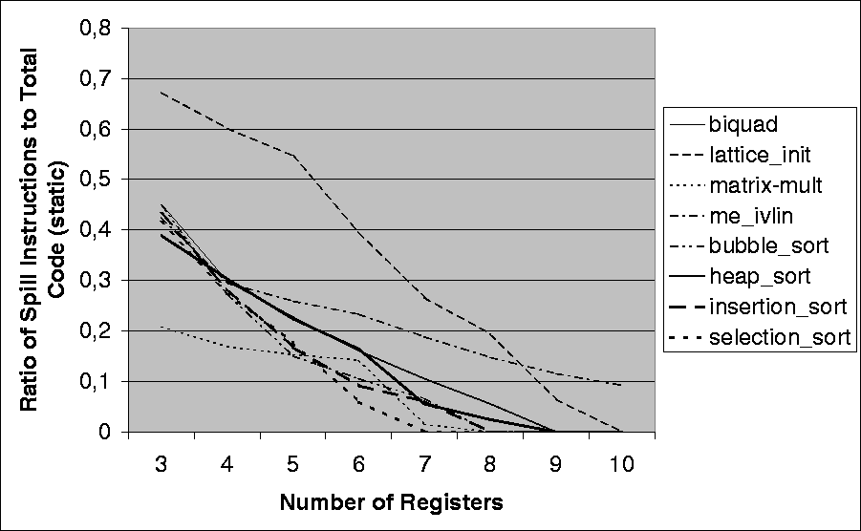
Static Analysis
Ratio of spill code to total static code size
Notes:
In this graph you can see the obtaines results for the ratio of spill code to total static code size. For this static analysis, we varied the number of registers from 3 to 10, since we do not need the instruction set simulator to be able to execute the generated programs. The compiler thus generated something like "symbolic assembly code".
As expected, there is a strong, pseudo-linear decrease in spill code ratio when the number of registers is increased. This makes sense since in the extreme case where you have an infinite number of registers, you will never need any spill instructions in your assembly code. In this case the spill code ratio will of course be 0. In this graph we can thus see how many registers an application requires to be able to execute without having to spill any values to memory. The spil code ratio gives a measure for the number of concurrently live values in the registers. The benchmarks we used for our experiments saturate (i.e. they contain no more spill code) at register numbers between 7 and 19. This number allows the ASIP designer to make a first estimation how many registers the targetted ASIP should have so that the code quality does not degrade due to spilling.
Now this static analysis is without question interesting, however, it does not give any "real" information about the way the application will behave when it is actually executed on the target processor. If e.g. a value within the innermost loop of the application has to be spilled, it is only counted once for this matter, even though it is executed an order of magnitude more frequently than a spill that takes place outside of any loops. In order to really see the consequences of spilling a variable to memory, we need to include some dynamic information, i.e. observations taken when the program is indeed being run. This is also necessary to obtain any results concerning power.

Slide 16
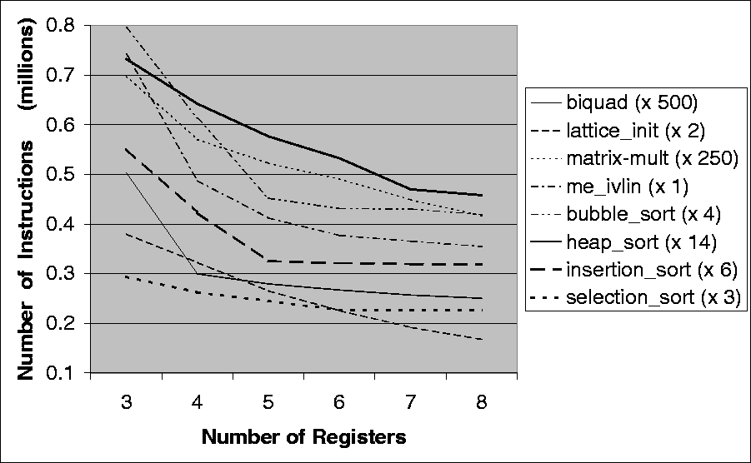
Dynamic Analysis
Number of executed instructions
Notes:
We have thus extracted information on the runtime behavior of the applications using the instruction set simulator and trace analyzer. The result can be seen here:
First of all, we only counted the number of instructions that are being executed when a program is run, i.e. we did not only count the static number of instructions in the assembly file, but the execution frequency of the instructions was also taken into account. Spilling instructions of course increase the total number of executed instructions, so we see basically the same trends as in the previous figure, but the trend becomes somewhat clearer. A spill within an inner loop will now be counted as many times as the instruction is being executed. It is obvious that spilling within the innermost loop is extremely inefficient and should be avoided by the compiler.
(In order to do this, it is common to keep track of an iteration count for each statement which approximates the number of times this statement will be executed. Based on this data, the compiler can choose places outside of loops for spilling first and only resort to inner loops when there is no other choice.)
Please note that the curves were scaled so that they can all be displayed in one sinlge plot.
If you've been looking at the graph intensively, you may have wondered why there is a peculiar bend in some of the curves - the decrease in number of executed instructions is very strong up to a certain point, where the curve "levels out" a little. This can be seen quite clearly in the insertion_sort benchmark: The strong bend in the curve occurs if the number of registers is increased from 4 to 5 registers - if we have only 4 registers, the value is significantly higher than for 5 registers, however, if we use 6 registers, the value is not very much lower. So something must be happening within this benchmark when we switch from 4 to 5 registers.

Slide 17
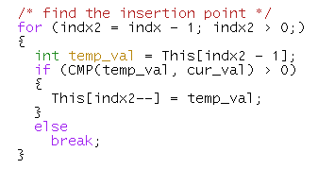
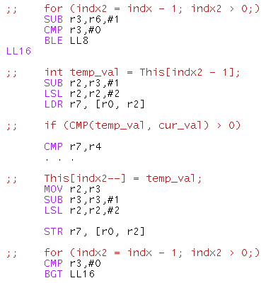
Application Analysis
indx2 ⇒ r3
indx2-1, (indx2-1)*4 ⇒ r2
This[] ⇒ r0
temp_val, This[indx2-1] ⇒ r7
cur_val ⇒ r4
Σ = 5 registers
Notes:
In order to show what is happening, I have the source code of the innermost loop of the application here, along with the generated assembly code for 5 registers: If we look at the assembly code on the right, we can analyze which of the values in the C-code corresponds to which register.
The first statement is a subtraction of the value 1, so we can deduce that Indx2 is being stored in registers r3 (Indx is in r6, but this value is not written to in this innermost loop, so it can be ignored here). The next subtraction shows that Indx2-1 is stored in register r2.
The following logical shift left (LSL) multiplies this value by 4 - this is the address calculation necessary to access data in the array called This in the C-code. We thus have (Indx2-1)*4 in register r2 - notice how the register allocator within the compiler cleverly reuses register r2 to reduce register pressure.
The value of This[indx2-1] is thus retrieved from memory using a LDR-statement - the base address of array This is stored in register r0 (used as the base registers in the Load with offset instruction), the result is stored in r7. Since This[indx2-1] is directly assigned to temp_val, temp_val is also stored in r7.
As we can see in the comparison of temp_val and cur_val (CMP is a macro that is actually being extended, I just tried to keep it short), cur_val resides in register r4.
Looking at the assembly code after this point, we notice that all registers are being reused (for indx2, indx2-1, (indx2-1)*4), so no new registers are assigned.
What does this show? Within this innermost loop, 5 registers are needed to hold all the values that are concurrently live. If 5 registers are avaliable (as in the case shown here), there is no need to introduce any spill code to the innermost loop. If there are only 4 registers, however, the code generator has to insert spill code within the innermost loop, which is being executed many many times. This effect actually leads to the sharp bend in the curve that we saw on the previous slide.
Our analysis showed similar causes for the bends in the curves of the other benchmarks. It is interesting that with some knowledge about how assembly code is being generated, it is possible to estimate the number of required registers only by looking at the C-code. If the analysis is concentrated on the innermost loop (where spilling has the most negative effect), the effort to perform this analysis is quite low.

Slide 18
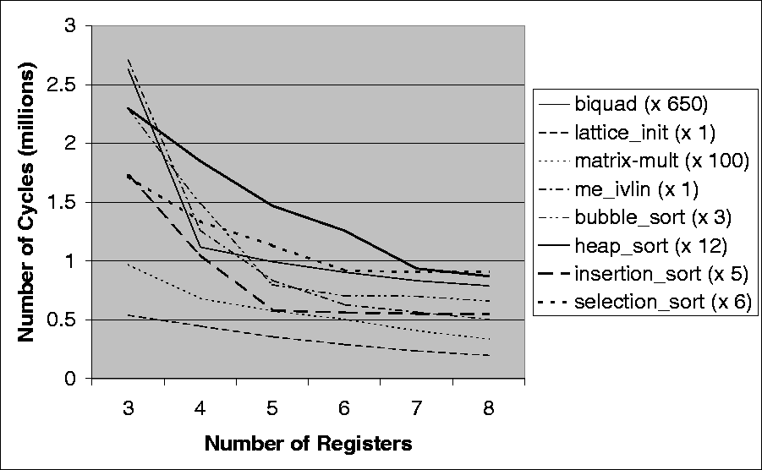
Dynamic Analysis
Number of cycles
Notes:
In this figure, we did not count the number of inxtructions that are being executed, but the number of cycles required for execution. Using the ARM7TDMI processor, we can say that the number of cycles per instructions varies from 1 to 5. The behavior of the curves is roughly the same as for the number of instructions. Since the sloping of the curves is due to additional Load and Store instructions, and Loads and Stores take more cycles to execute than the average e.g. arithmetic instruction (LD: 3, ST: 2), the slopes and the bends are somewhat more distinct.
We can thus say that basically we only improved the resolution compared to the number of instructions figure.

Slide 19
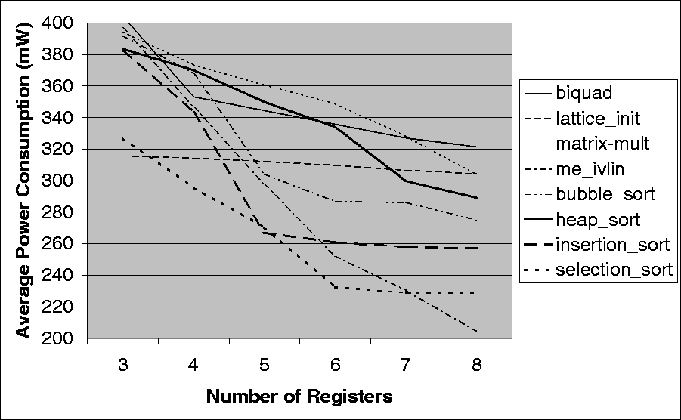
Dynamic Analysis
Power Consumption
Notes:
This figure shows the power consumption of the benchmarks when they are executed. As mentioned earlier, this information is taken from the power database that is used both by the compiler and the trace analyzer. This figure thus contains part of the output produced by the trace analyzer.
For these values, I have to give some more information on how the data was collected: I mentioned earlier-on that the evaluation board we used for our power model measurements has two kinds of memory: a 4 KB On-Chip Scratch-Pad memory and a 512 KB Off-Chip RAM. The Software Development Toolikit that is supplied along with the board allows the user to put different kinds of memory objects (e.g. instruction, data) into different types of memory. For our observations, we chose to put the instructions into on chip memory and the data into off chip RAM since this produced the clearest results. Instruction fetching has to be performed anyway, so we are not really interested in its contribution to power consumption. If the instructions are in on chip memory, the power required to access the instructions is very small compared to an off chip access. The spilled variables on the other hand (the effect we want to see) were kept in the off chip RAM, so that each access consumes a considerable amount of energy. In this configuration, each variabale spilled to memory has a strong effect on power consumption.
If both instructions and data were kept in off chip RAM, the curves turned out to be nearly horizontal, i.e. there was no perceivable effect of the change of register file size.
But the configuration we chose also reflects the situtaion found in many embedded systems today: the instructions are usually stored in a low power ROM module, whereas the dynamic data is ofetn stored in an external RAM. The obtained results can thus be transferred to many embedded systems using this memory architecture.
(In this figure it is also interesting to take a look at the absolute values of the curves: The higest value is shown for matrix-mult. This is due to the fact that within the innermost loop of this application, the multiplication of two array elements is performed and the result is stored back in another array. This means there are 3 off-chipmemory accesses (two Loads, one Store) and one multiplication which also consumes a lot of power.
For the sorting algorithms we can state that their position in this plot shows how often the data elements are being moved from one position to another. A small number of such data transfers are a sign of good efficiency of the algorithm – at least where power consumption is concerned)

Slide 20
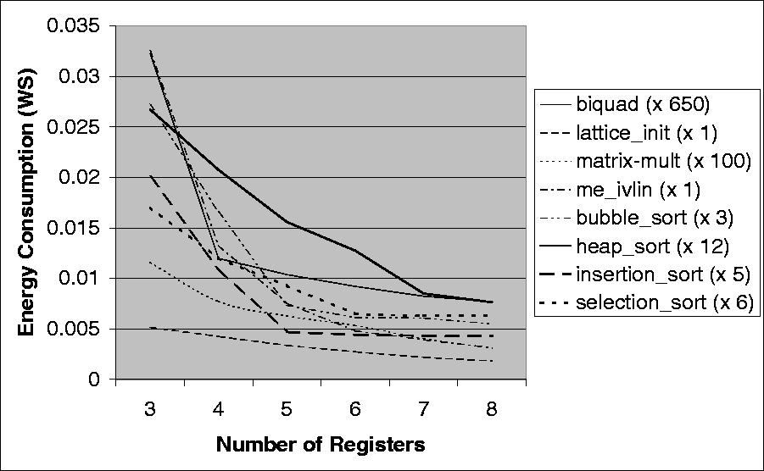
Dynamic Analysis
Energy Consumption
Notes:
The information shown in this plot has already been given: Since Energy is the product of power and time (i.e. number of cycles), the qualitative behavior of the curves is pretty obvious: power as well as cycle times decreased for increasing register file size, so energy should decrease strongly, which is the case.
Now since energy is the factor responsible for battery lifetime in portable embedded systems, it seems important to consider this value in ASIP design. Since energy aware code generation is also my main area of research, the following table shows results concerning energy consumption:

Slide 21
Obtained Results: Energy
3 → 4 4 → 5 5 → 6 6 → 7 7→8 Average
biquad 62,89% 13,35% 11,26% 10,42% 6,71% 20,93%
lattice_init 17,45% 20,97% 18,92% 19,78% 16,84% 18,79%
matrix-mult 33,44% 18,57% 14,99% 24,26% 23,28% 22,91%
me_ivlin 59,28% 43,16% 36,29% 18,24% 20,47% 35,49%
bubble_sort 39,07% 55,63% 16,78% 0,74% 9,63% 24,37%
heap_sort 22,35% 24,87% 18,27% 33,24% 10,16% 21,78%
insertion_sort 45,47% 57,11% 5,60% 2,63% 0,92% 22,35%
selection_sort 29,68% 22,59% 30,14% 2,94% 0,00% 17,07%
Average 38,70% 32,03% 19,03% 14,03% 11,00% 22,96%
Notes:
We have put down the percentual energy savings possible when one additional register is considered. E.g. if we increase the number of registers from 3 to 4, the biquad Benchmark requires 63% less energy to execute. The overall average over these values is an improvement of nearly 23% of total energy consumption when one more register is added. Of course, this depends strongly on the range the register file size is modified within: You can see that for seelction_sort, the improvement from 7 to 8 registers is 0. This means this benchmark is saturated at 7 registers and does not profit from any additional registers. This will be the case for all of the benchmarks for some application dependent register file size. Any further increase in the number of registers will not have a positive effect on the energy consumption.
The average-per-row value is thus only valid for the considered range from 3 to 8 registers. It shows much each application will benefit from additional registers.
The average-per-column show how much the considered benchmarks benefit from changing register file size from 3 to 4, 4 to 5 etc. It is obvious that this value is largest for the change from 3 to 4 registers, since most of the benchmarks will require spill code within the innermost loop when they only have 3 registers available.

Slide 22
Conclusion, Future Work
Conclusion:
strong impact on performance and energy dissipation
tradeoff point is application dependent
application properties were identified
Future Work:
additional observations e.g. for the LEON processor
consider power consumption of additional registers
use of compiler supporting specific features of the ASIP
Notes:
What are our results?
All the figure s show that the register file size has a strong impact on application performance (in terms of execution time) and energy dissipation. This architectural parameter should thus be considered at an early stage during ASIP synthesis.
The point where it is pointless to add further registers depends on the considered application. One application in our benchmark suite only saturates at 19 registers, i.e. up to this point it does make a certain amount of sense to keep addding more registers, whereas another benchmark does not profit from more thatn 7 registers. To see why this is tradeoff, one has to consider that additional registers will also result in further energy dissipation, a factor that has not been considered in our word.
The application properties that cause some of the sharp bends in the curves were identified. We showed that by looking at the innermost loop even in C-code, it is often possible to estimate the minimum number of registers required for an acceptable performance. This fact makes enables the ASIP designer to consider register file size at a very early point in the design flow. Only the C-code is required for a first rough estimate.
Out future woirk will consist of performing additional experiments with different processors, e.g. the LEON processor. Some observations were already taken for this SPARC-compliant architecture, but since the trends were the same due to the strong resemblance of the two processors, the results were ommitted here.
Each additional register consumes power – as I already mentioned, this fact is not considered in this work. Adding this information to the design flow, one could use equation solvers to determine the optimal register file size concerning spill code and regiser file power.
Finally, in our encc compiler we were not able to respect some of the special architectural features some ASIPs have. This should be included at some time in the future, so that efficient code can be generated that actually exploits these features.

